Slide 1
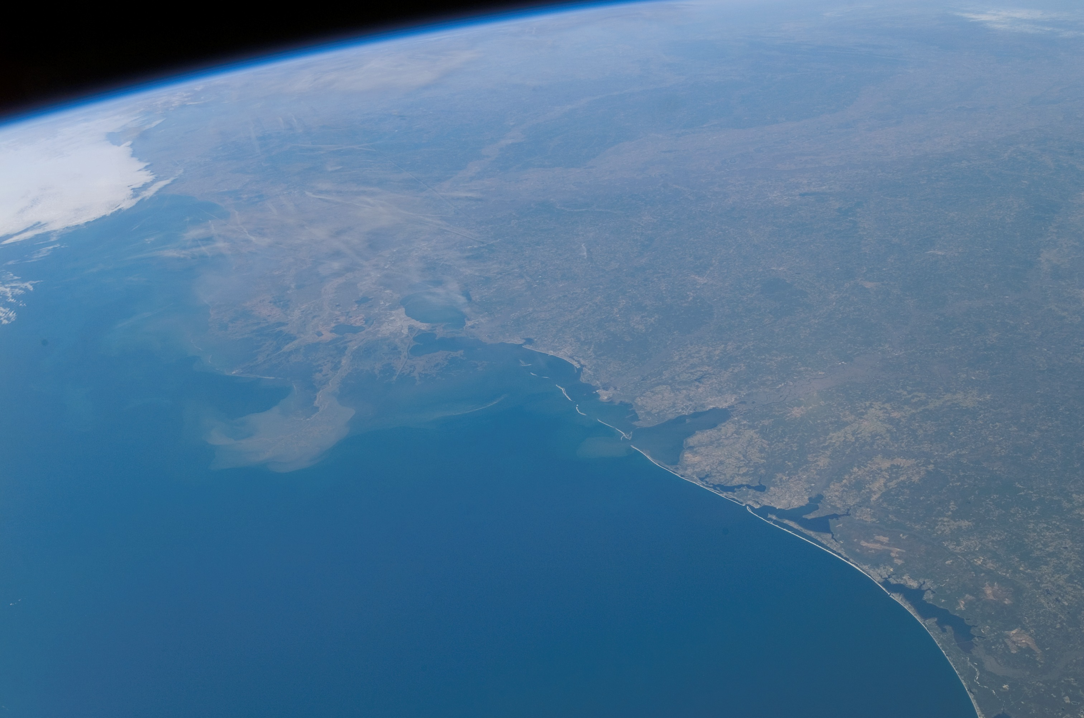
A statistical model of the global carbon budget climate econometrics virtual seminar series 15. december 2020
Mikkel Bennedsen
Aarhus Universitet
and CREATES
Eric Hillebrand
Aarhus Universitet
and CREATES
Siem Jan Koopman
Vrije Universiteit Amsterdam
and CREATES
Econometric Models of Climate Change

Slide 2
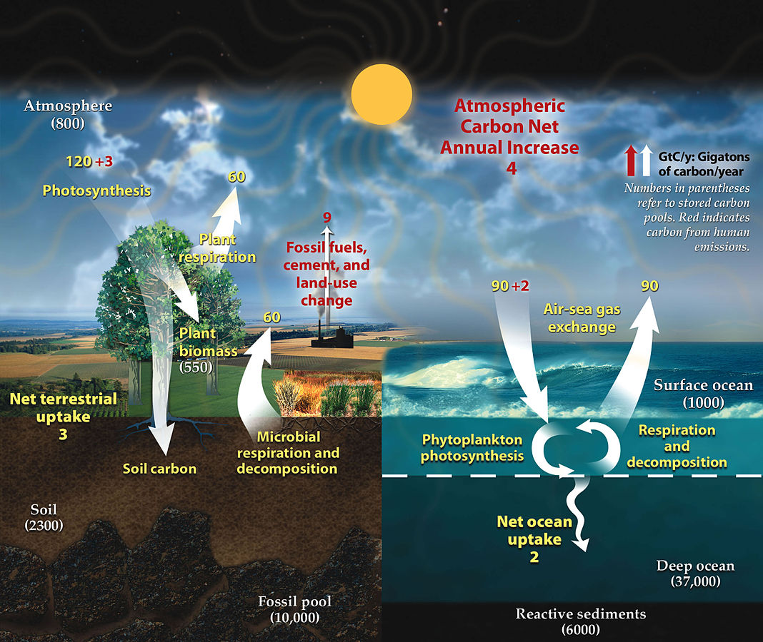
Global Carbon cycle
Source:
Wikipedia

Slide 3

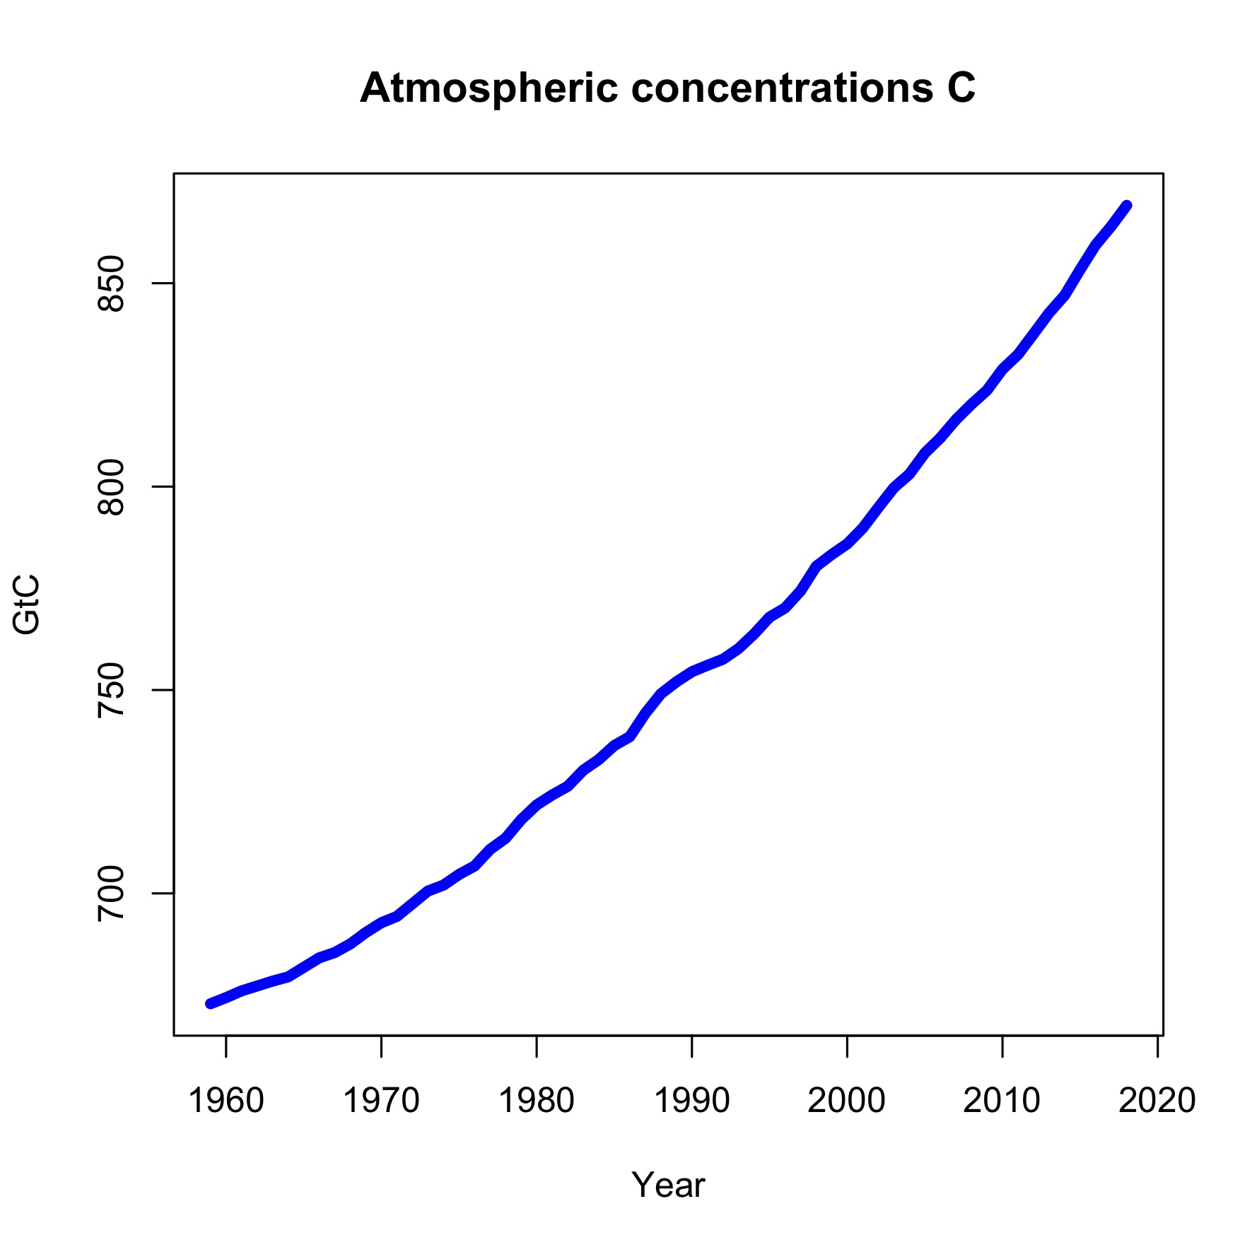
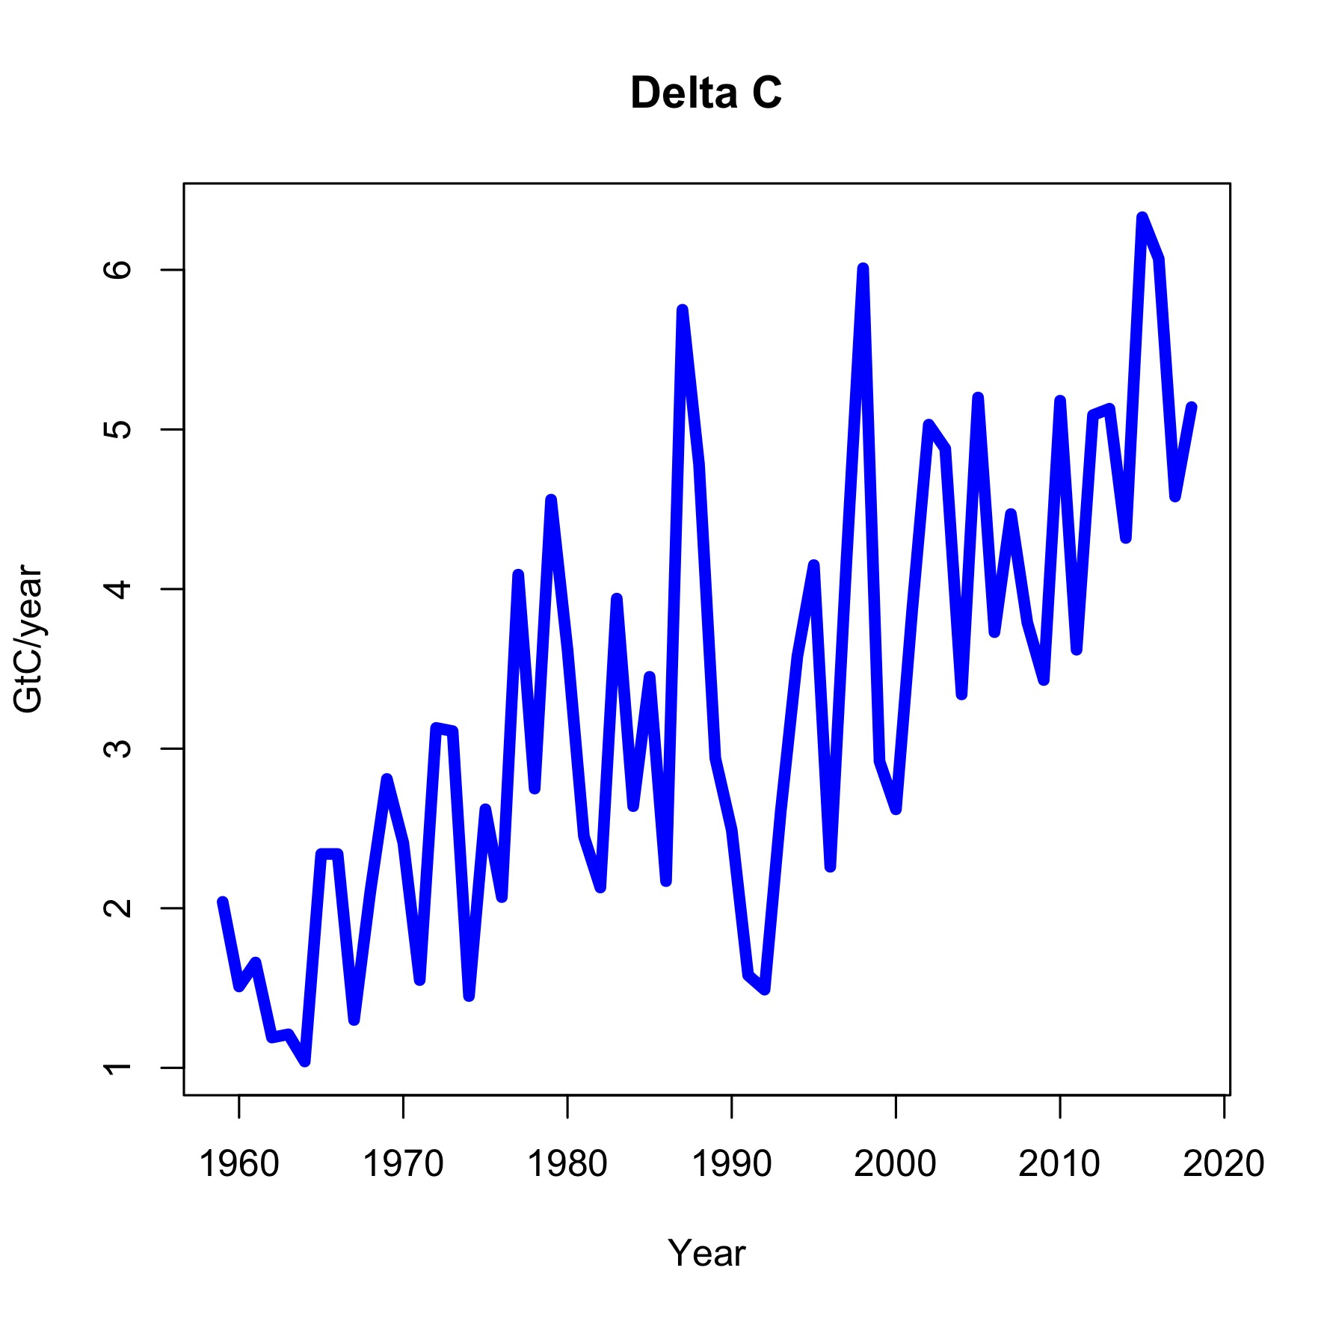
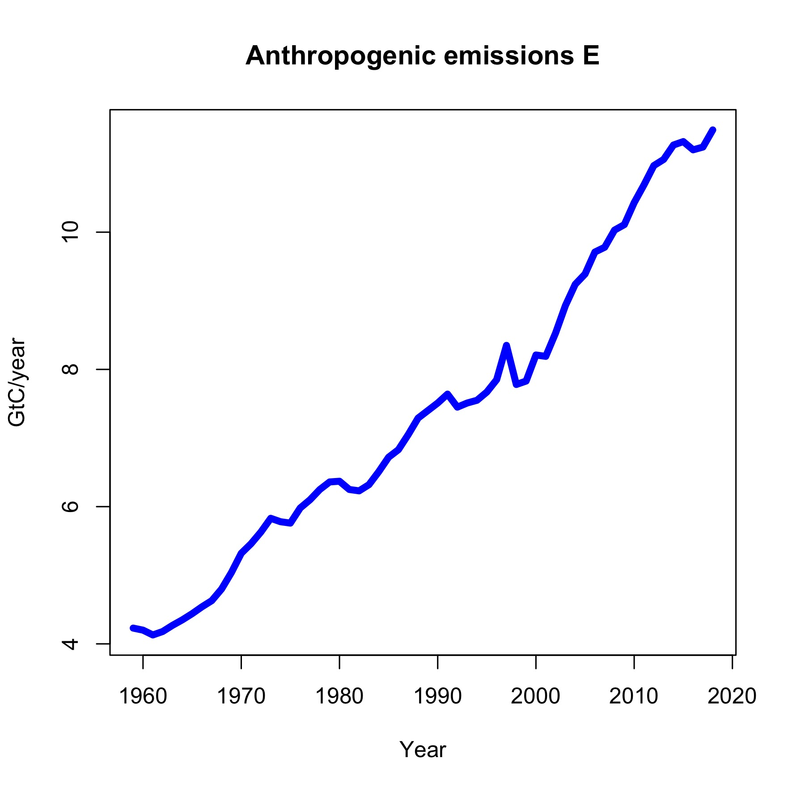
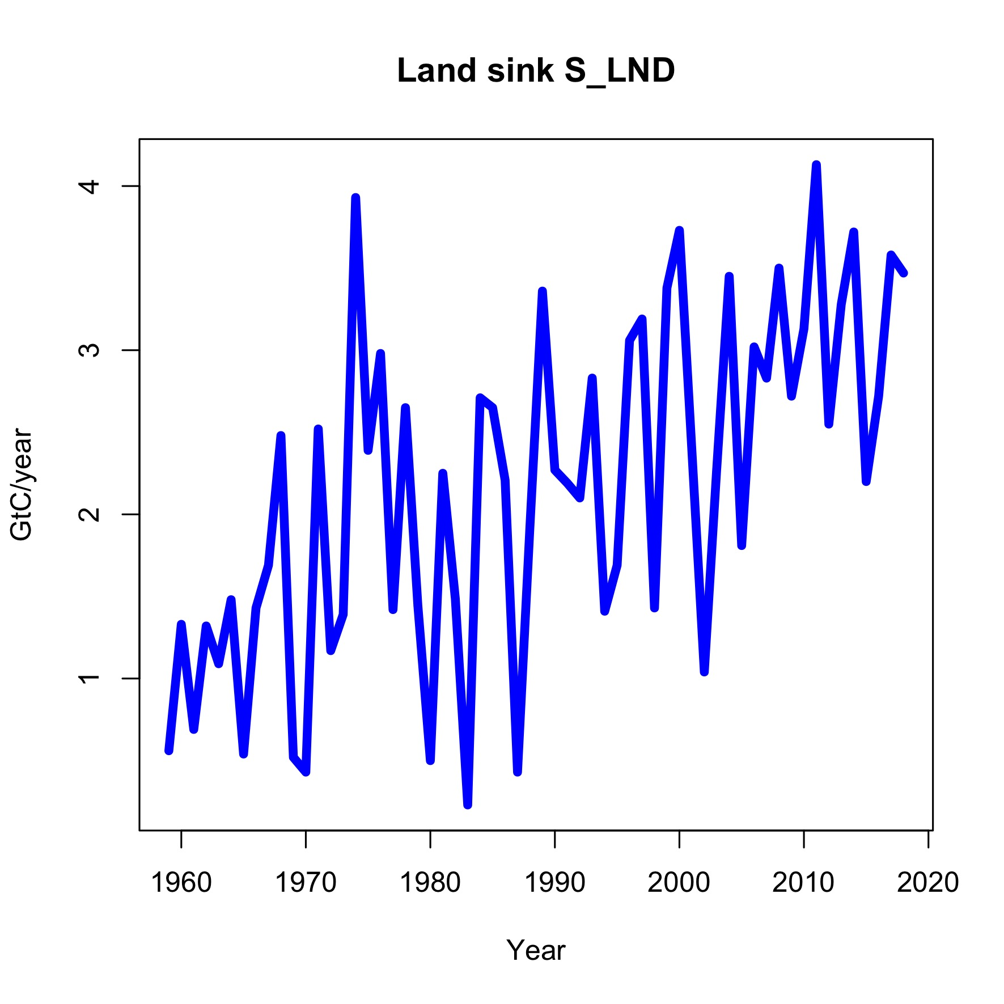
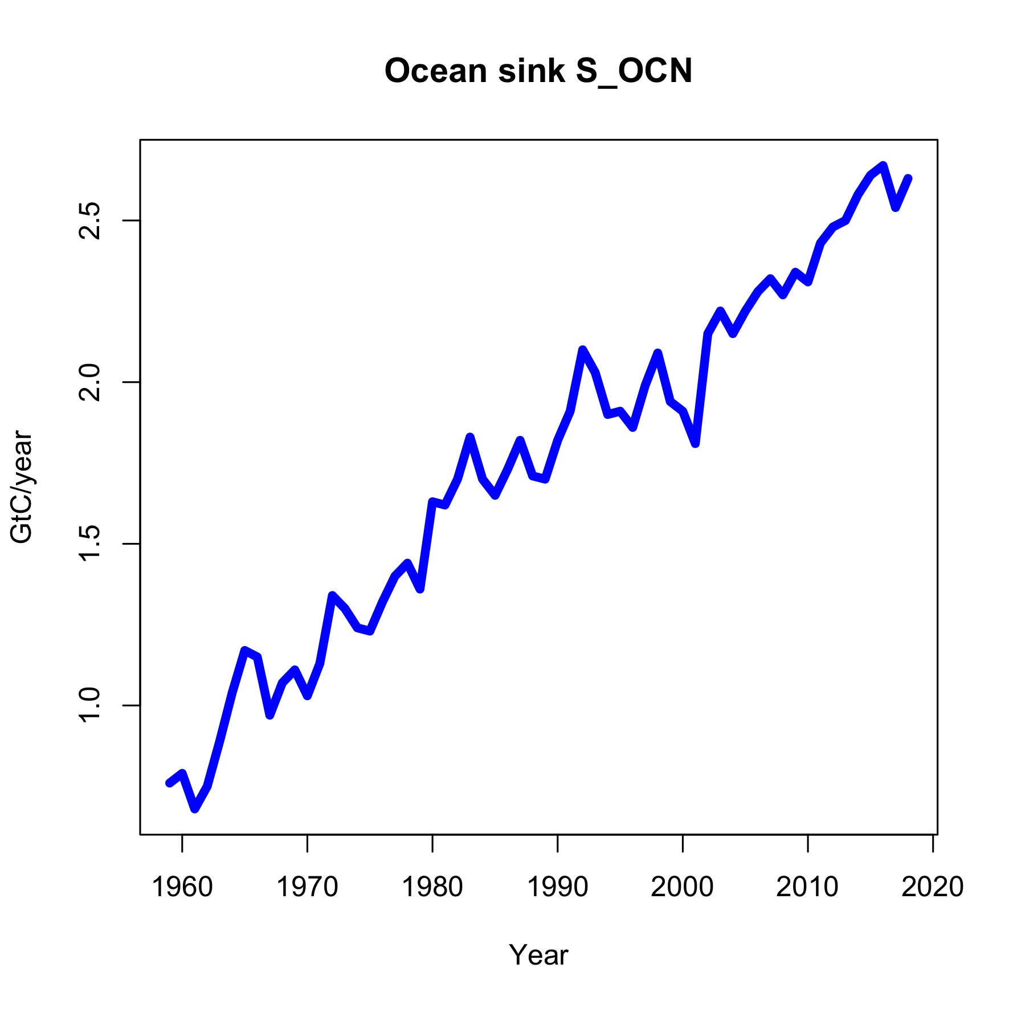
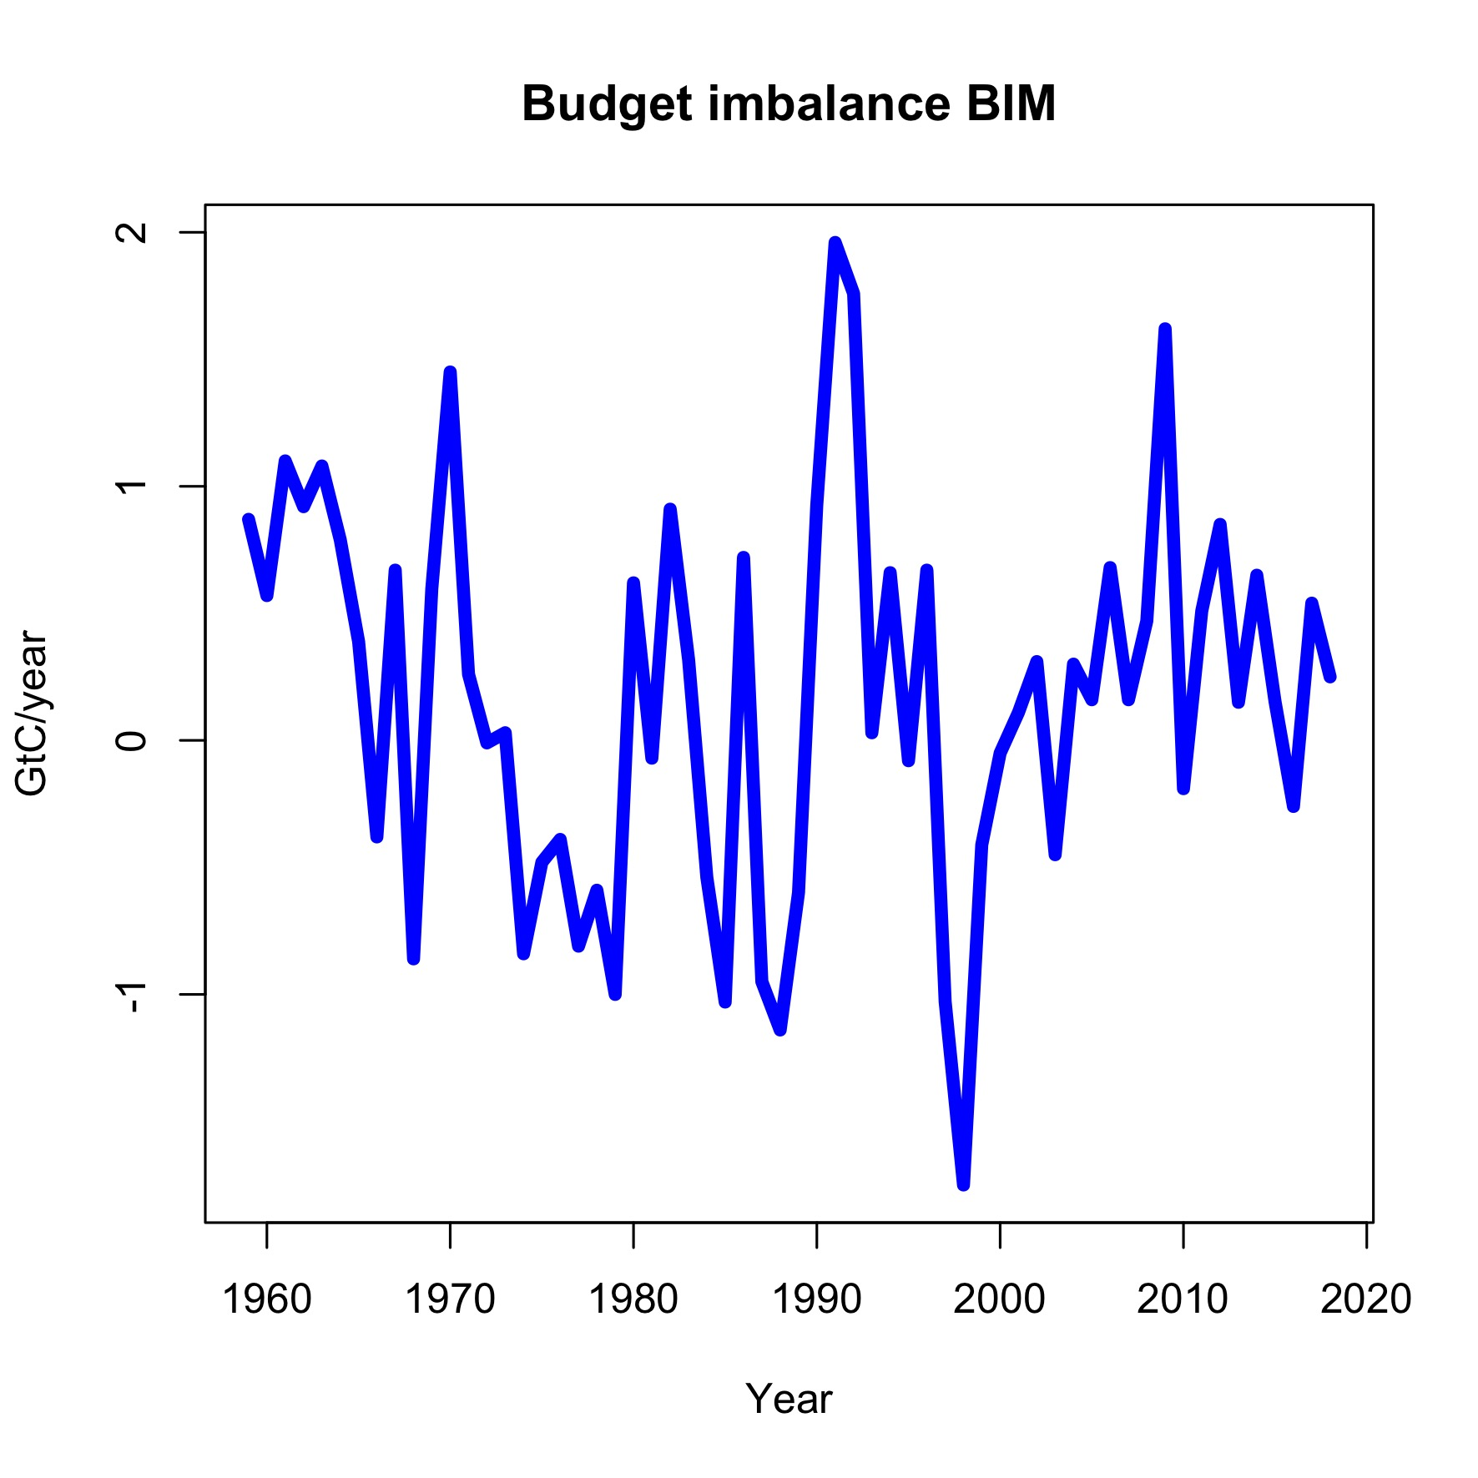
data
www.globalcarbonproject.org
Friedlingsstein et al. (2019),
The gobal carbon budget 2019,
Earth System Science Data 11(4),
1783-1838
△
=
=
-
-
+

Slide 4
Outline of the talk
Models for the components of the global carbon budget
The dynamics of atmospheric concentrations C
The system model
Esimation: Residual diagnostics, Residual processes, Parameter estimates
Simulation
Discussion: Budget imbalance, airborne fraction, sink rate
Nowcasts and forecasts
Projections: Long-term scenarios until 2100
Conclusions

Slide 5
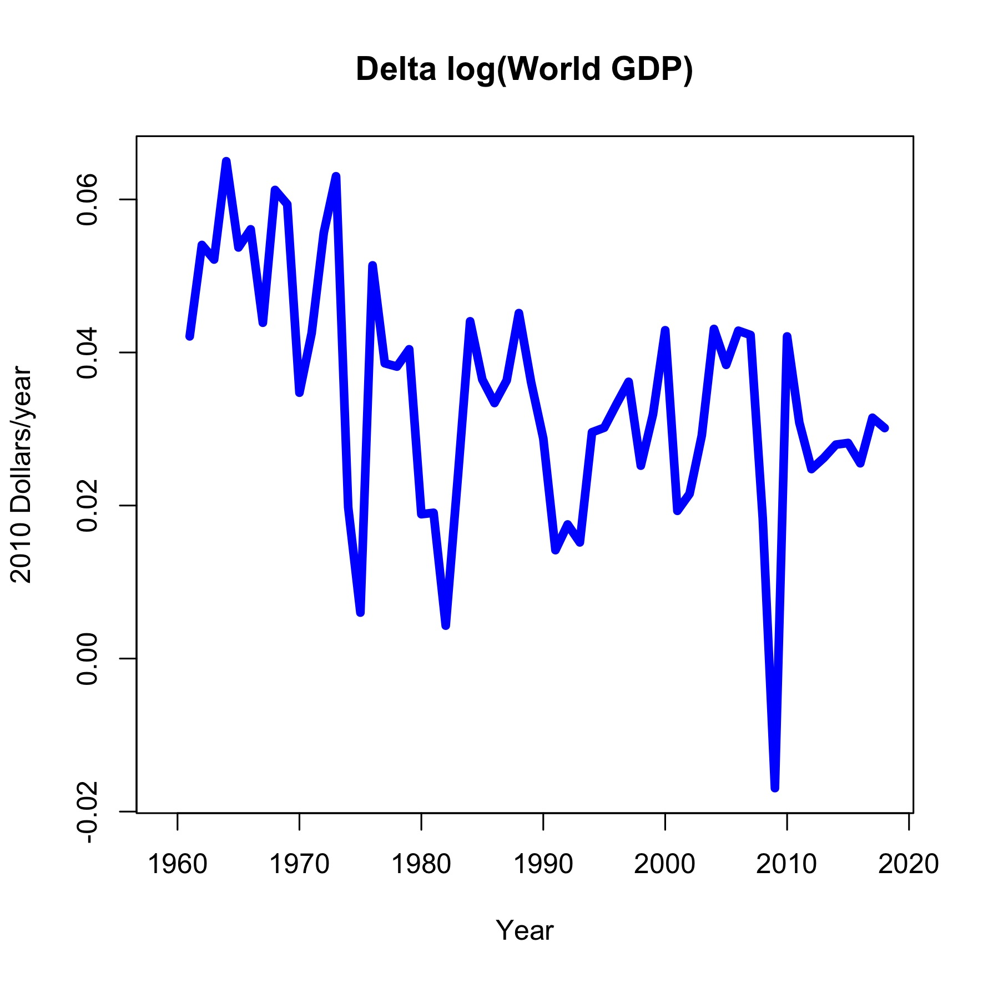
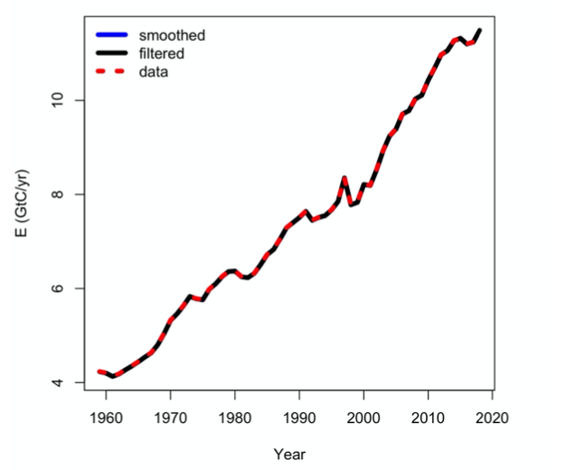
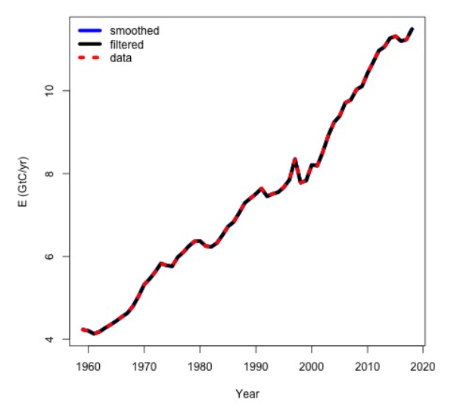
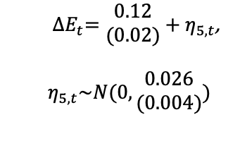
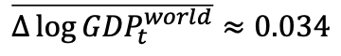
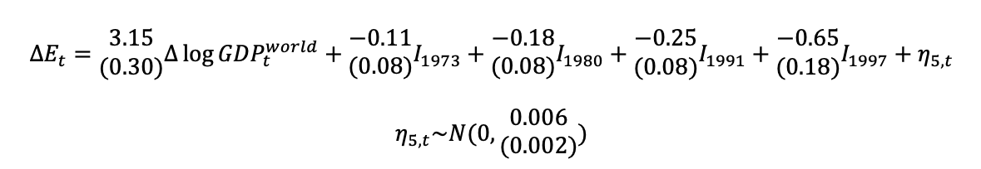
Anthropogenic Emissions
$$\overline{Δ\log{{GDP}_{t}^{world}}}≈0.034$$
$${ ΔE}_{t}=\begin{matrix}0.12 \\ (0.02)\end{matrix}+η_{5,t}\text{, }$$
$${ η}_{5,t}\sim N(0,\begin{matrix}0.026 \\ (0.004)\end{matrix})$$
$${ΔE}_{t}=\begin{matrix}3.15 \\ (0.30)\end{matrix}Δ\log{{GDP}_{t}^{world}}+\begin{matrix}−0.11 \\ (0.08)\end{matrix}I_{1973}+{\begin{matrix}−0.18 \\ (0.08)\end{matrix}I}_{1980}+{\begin{matrix}−0.25 \\ (0.08)\end{matrix}I}_{1991}+{\begin{matrix}−0.65 \\ (0.18)\end{matrix}I}_{1997}+η_{5,t}$$
$$η_{5,t}\sim N(0,\begin{matrix}0.006 \\ (0.002)\end{matrix})$$
Notes:
1760 steam engine – wood burning
1880s electric light – coal mining
1920s fossil fuel emissions dominant emissions

Slide 6
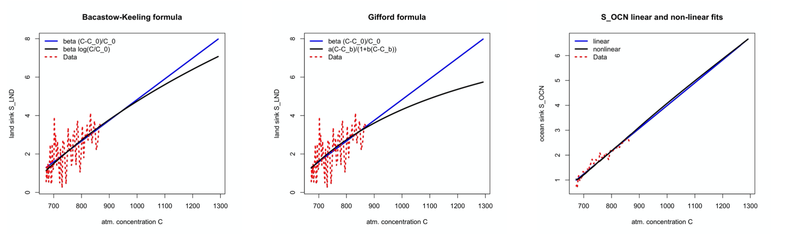
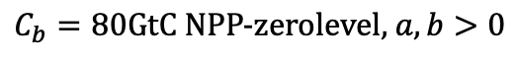
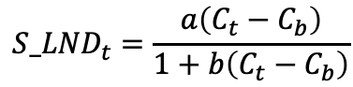
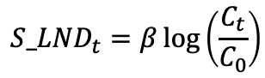
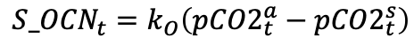
sinkS linear in concentrations
$${S_LND}_{t}=β\log\left(\frac{C_{t}}{C_{0}}\right)$$
$${S_LND}_{t}=\frac{a\left(C_{t}−C_{b}\right)}{1+b\left(C_{t}−C_{b}\right)}$$
$${S_OCN}_{t}=k_{O}\left({pCO2}_{t}^{a}−{pCO2}_{t}^{s}\right)$$
Joos et al. (1996, 2001)
Meinshausen et al. (2011)
$$C_{0} \text{pre}\text{−}\text{industrial} \text{concentration}\text{ 593}\text{GtC} \text{or}\text{ 279}\text{ppm}$$
$$C_{b}=80\text{GtC} \text{NPP}\text{−}\text{zerolevel}\text{, }a,b>0$$

Slide 7
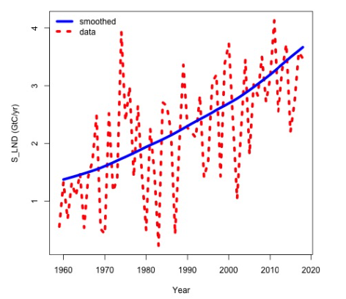
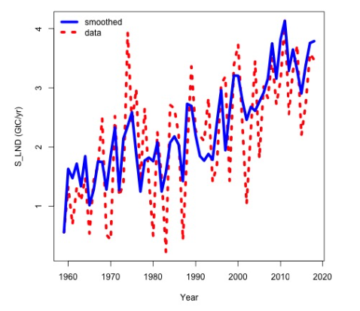
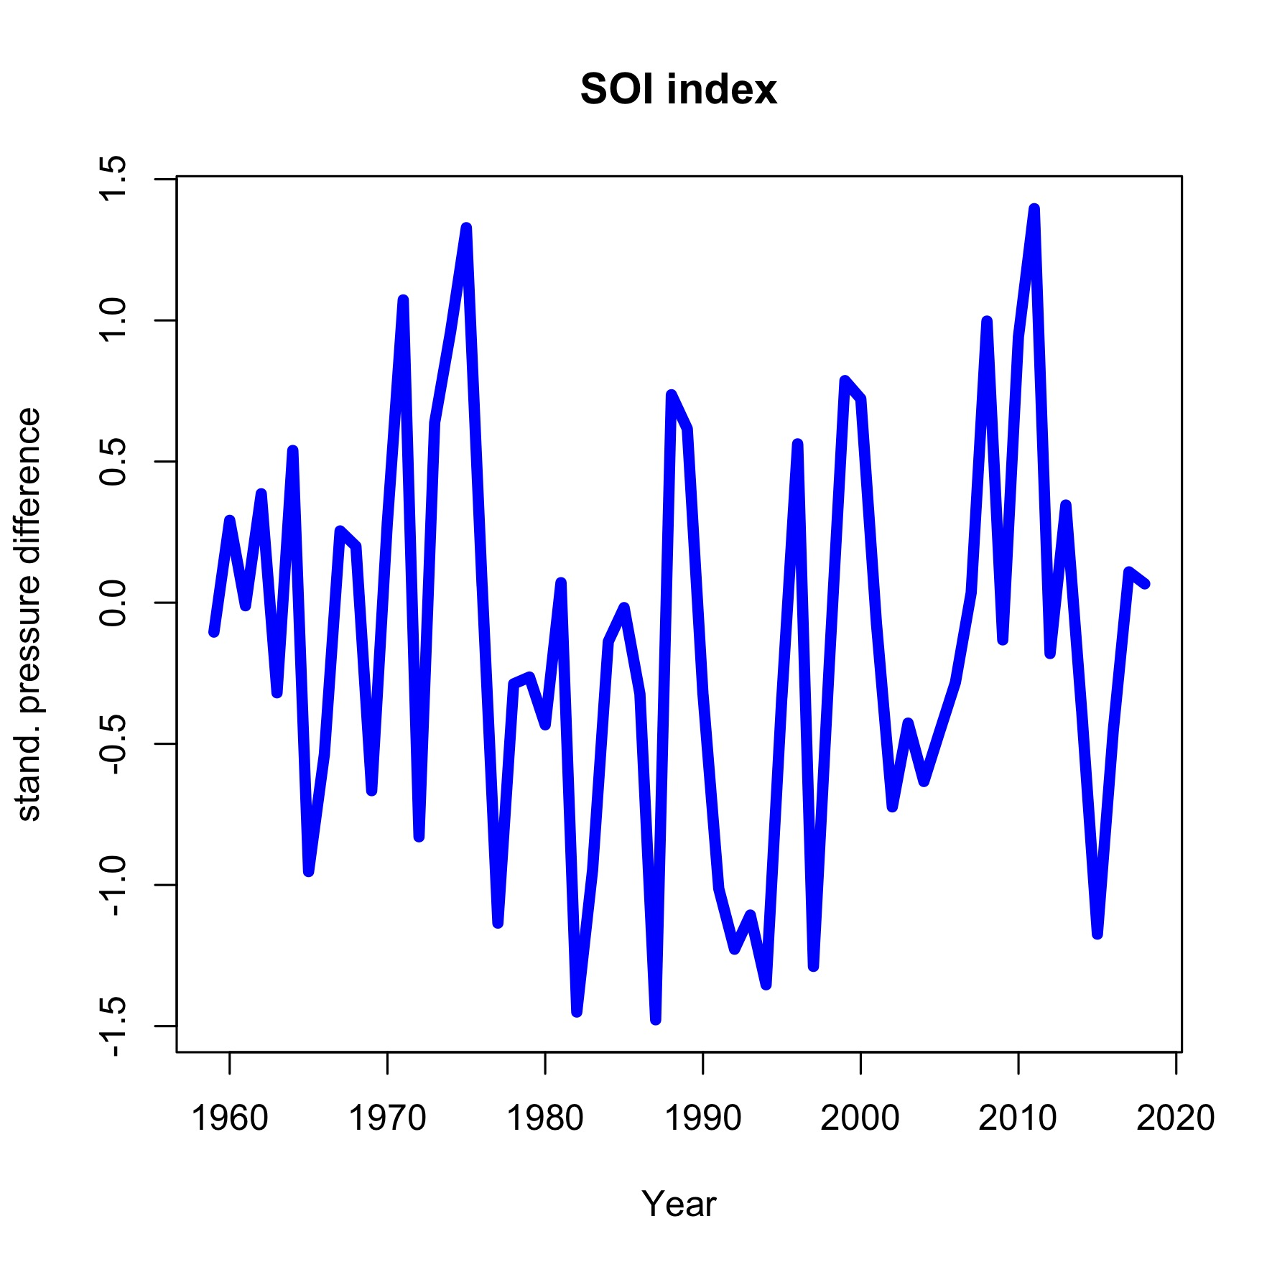
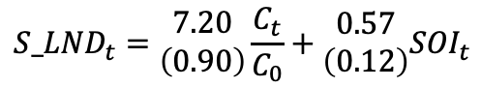
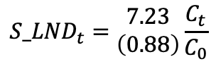
Land sink
“Moisture sensitivities of both productivity and
decomposition are important for capturing
the response of the net flux to such [La Nina]
events.” Haverd et al. (2018, p. 3013)
$${S_LND}_{t}=\begin{matrix}7.23 \\ \left(0.88\right)\end{matrix}\frac{C_{t}}{C_{0}}$$
$${S_LND}_{t}=\begin{matrix}7.20 \\ \left(0.90\right)\end{matrix}\frac{C_{t}}{C_{0}}+\begin{matrix}0.57 \\ \left(0.12\right)\end{matrix}{SOI}_{t}$$

Slide 8
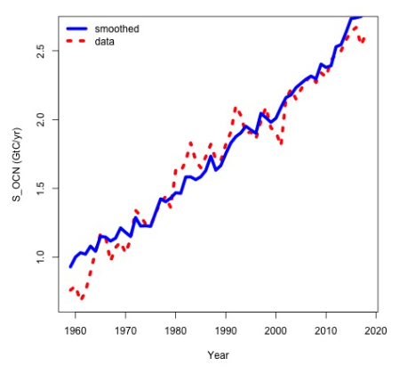
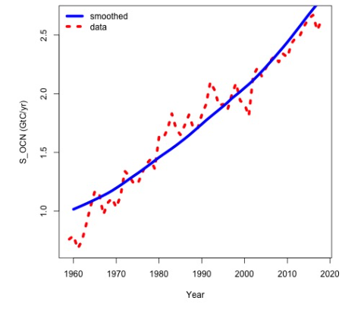
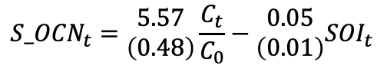
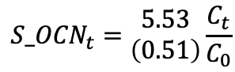
ocean sink
“When the winds are strongest during the cold
cycle of ENSO deep upwelling occurs and
[ocean CO2 partial pressure] values are at a
maximum .” Feely et al. (1999, p. 599)
$${S_OCN}_{t}=\begin{matrix}5.53 \\ \left(0.51\right)\end{matrix}\frac{C_{t}}{C_{0}}$$
$${S_OCN}_{t}=\begin{matrix}5.57 \\ \left(0.48\right)\end{matrix}\frac{C_{t}}{C_{0}}−\begin{matrix}0.05 \\ \left(0.01\right)\end{matrix}{SOI}_{t}$$

Slide 9
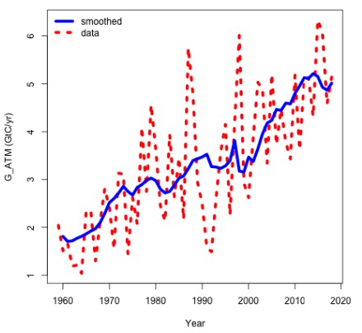
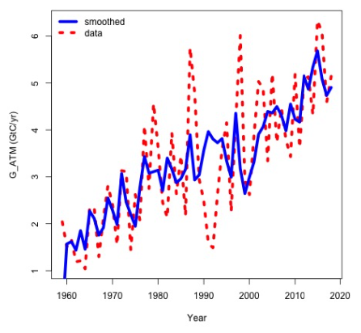
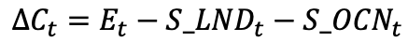
△C = growth in atm. concentrations
$$ΔC_{t}=E_{t}−{S_LND}_{t}−{S_OCN}_{t}$$

Slide 10
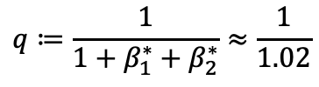
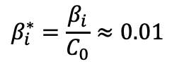
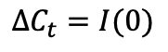
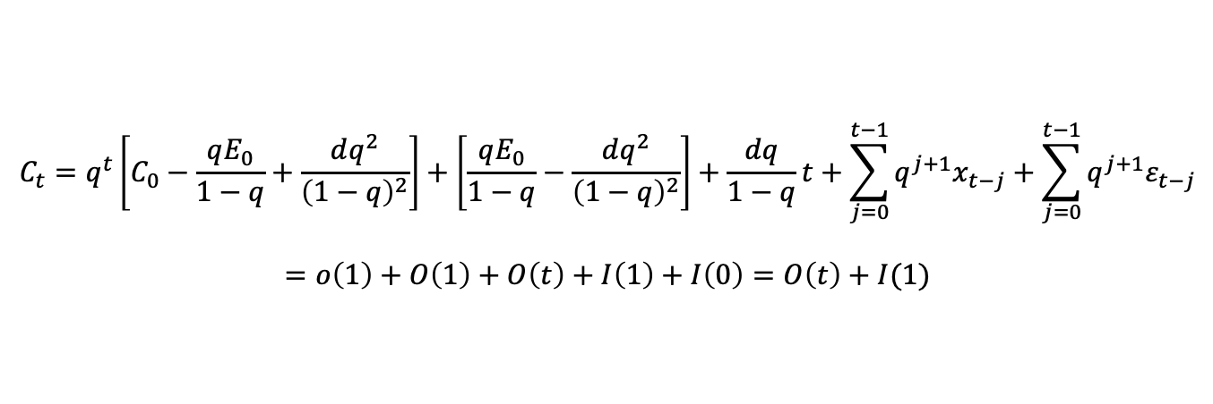
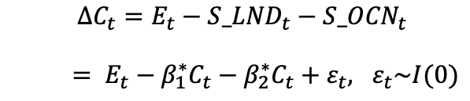
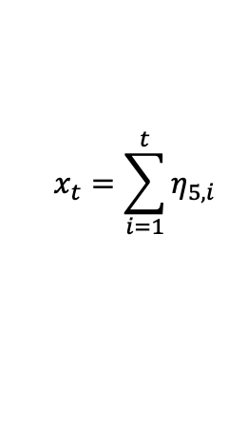
The dynamics of c
$$ΔC_{t}=E_{t}−{S_LND}_{t}−{S_OCN}_{t}$$
$= E_{t}−β_{1}^{∗}C_{t}−β_{2}^{∗}C_{t}+ε_{t}, ε_{t}\sim I(0)$
$$β_{i}^{∗}=\frac{β_{i}}{C_{0}}≈0.01$$
$$x_{t}=\sum_{i=1}^{t}{η_{5,i}}$$
$$\left(1+β_{1}^{∗}+β_{2}^{∗}\right)C_{t}−C_{t−1}=E_{0}+dt+x_{t}+ε_{t}$$
$$\left(1−qL\right)C_{t}={qE}_{0}+qdt+{qx}_{t}+{qε}_{t}$$
$$q≔\frac{1}{1+β_{1}^{∗}+β_{2}^{∗}}≈\frac{1}{1.02}$$
Three insights:
$$C_{t}=q^{t}\left[C_{0}−\frac{qE_{0}}{1−q}+\frac{dq^{2}}{{\left(1−q\right)}^{2}}\right]+\left[\frac{qE_{0}}{1−q}−\frac{dq^{2}}{{\left(1−q\right)}^{2}}\right]+\frac{dq}{1−q}t+\sum_{j=0}^{t−1}{q^{j+1}x_{t−j}}+\sum_{j=0}^{t−1}{q^{j+1}ε_{t−j}}$$
$$=o\left(1\right)+O\left(1\right)+O\left(t\right)+I\left(1\right)+I\left(0\right)=O\left(t\right)+I(1)$$
Thus,
$$ΔC_{t}=I(0)$$
But,
$$\left(1−qL\right){\left(1−L\right)C}_{t}=qd+{qΔx}_{t}+{qΔε}_{t}=I(0)$$

Slide 11
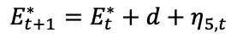
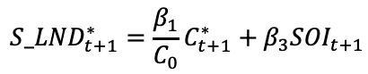
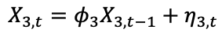
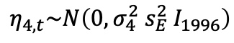
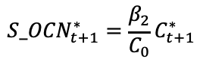
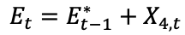
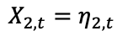
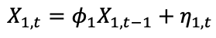
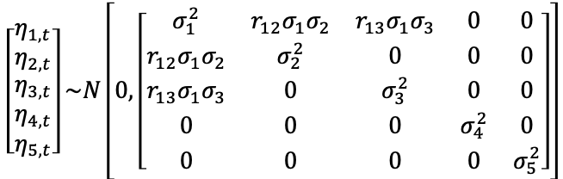
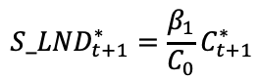
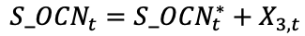
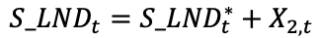
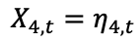



The system model
State equation Model 1
State equation Model 2
Measurement equation
$${S_LND}_{t+1}^{∗}=\frac{β_{1}}{C_{0}}C_{t+1}^{∗}$$
$${S_LND}_{t+1}^{∗}=\frac{β_{1}}{C_{0}}C_{t+1}^{∗}+β_{3}{SOI}_{t+1}$$
$$C_{t}=C_{t}^{∗}+X_{1,t}$$
$${S_OCN}_{t+1}^{∗}=\frac{β_{2}}{C_{0}}C_{t+1}^{∗}$$
$${S_OCN}_{t+1}^{∗}=\frac{β_{2}}{C_{0}}C_{t+1}^{∗}+β_{4}{SOI}_{t+1}$$
$${S_LND}_{t}={S_LND}_{t}^{∗}+X_{2,t}$$
$${S_OCN}_{t}={S_OCN}_{t}^{∗}+X_{3,t}$$
$$E_{t+1}^{∗}=E_{t}^{∗}+d+η_{5,t}$$
$$E_{t+1}^{∗}=E_{t}^{∗}+β_{5}Δ\log{{GDP}_{t+1}^{World}+ \text{dummies}}+η_{5,t}$$
$$E_{t}=E_{t−1}^{∗}+X_{4,t}$$
$$C_{t+1}^{∗}=C_{t}^{∗}+{G_ATM}_{t+1}^{∗}$$
$${G_ATM}_{t+1}^{∗}=E_{t+1}^{∗}−{S_LND}_{t+1}^{∗}−{S_OCN}_{t+1}^{∗}$$
$$X_{1,t}=φ_{1}X_{1,t−1}+η_{1,t}$$
$$\left[\begin{matrix}η_{1,t} \\ η_{2,t} \\ \begin{aligned}η_{3,t} \\ η_{4,t} \\ η_{5,t}\end{aligned}\end{matrix}\right]\sim N\left[0,\left[\begin{matrix}σ_{1}^{2} & r_{12}σ_{1}σ_{2} & r_{13}σ_{1}σ_{3} & 0 & 0 \\ r_{12}σ_{1}σ_{2} & σ_{2}^{2} & 0 & 0 & 0 \\ r_{13}σ_{1}σ_{3} & 0 & σ_{3}^{2} & 0 & 0 \\ 0 & 0 & 0 & σ_{4}^{2} & 0 \\ 0 & 0 & 0 & 0 & σ_{5}^{2}\end{matrix}\right]\right]$$
$$X_{2,t}=η_{2,t}$$
$$η_{4,t}\sim N\left(0, σ_{4}^{2} s_{E}^{2} I_{1996}\right)$$
$$X_{3,t}=φ_{3}X_{3,t−1}+η_{3,t}$$
$$X_{4,t}=η_{4,t}$$

Slide 12


Residual diagnostics
Model 1
Model 2

Slide 13








Residual processes
$$X_{1,t} \text{in} C_{t}$$
$$X_{2,t} \text{in} {S_LND}_{t}$$
$$X_{3,t} \text{in} {S_OCN}_{t}$$
$$X_{4,t} \text{in} E_{t}$$

Slide 14

Parameter estimates
Model 2

Slide 15

Simulations of model 1
T=60
T=250
$$σ_{4}^{2}$$
exhibits “pile-up” problem (Stock and Watson 1998)

Slide 16

Budget imbalance

Slide 17



Airborne fraction and sink rate
$$AF=\frac{ΔC}{E}$$
$$SR=\frac{S_LND+S_OCN}{C}$$

Slide 18


Now-/forecasts
Forecasts of World GDP growth
from IMF and World Bank
Forecasts of SOI
from forecast model
of monthly SOI data
1866-1920, with
trigonometric seasonal
and second-order
trigonometric cycle w/
period about 4 years

Slide 19

Projections to 2100
Scenarios:
1% GDP growth
3.4% GDP growth
5% GDP growth
Piketty scenario:
3.4% til 2030
3% til 2050
1.5% til 2100

Slide 20
conclusions
Specification of state-space model for Global Carbon Budget
World GDP as driver in emissions
Sinks: linear in CO2 concentrations and in SOI
CO2 concentrations are I(1) ranging on I(2)
Model allows for forecasting, projections, study of key variables such as airborne fraction and sink rate
Future directions
Include ensemble members for S_LND and S_OCN
Factor model for drift in emissions using large macroeconomic dataset
Higher resolution on Global Carbon Cycle module (MAGICC)
Connection to temperatures (Energy Balance Models)
Cointegration analysis

